Slide 1
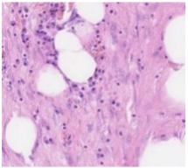
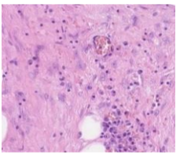
COSC2673 Machine Learning Aparupa Mitra Student id : S3831724 Classify Images of Colon Cancer
Notes:
Today I will present my project on classification of images of colon cancer.

Slide 2
Critical Analysis
Problem statement
Solution to the problem
Analysis of the model and its outputs
Other approaches considered
Limitations of the model developed
Is the approach adequate to solve the problem?
Notes:
Lets discuss about critical Analysis

Slide 3
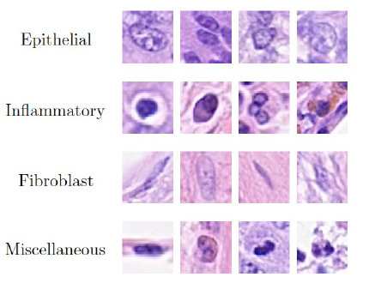
Problem Statement
1.Classify images according to whether given cell image represents
a cancerous cell or not
Target value for images :
isCancerous : 1 , not isCancerous :0
2. Classify images according to cell-type, such as: fibroblast,
inflammatory, epithelial or others.
Target value for images :
fibroblast : 0 , inflammatory : 1, epithelial : 2, others : 3

Slide 4
Solution
Model 1:
Convolutional Neural Network for predicting cell cancerous or not.
Combined two datasets ‘data_labels_mainData.csv’ and ‘data_labels_extraData.csv’ with target value 0 or 1
CNN with three VGG blocks (two layers of convolution layer and Max pooling layer)
Hyperparameter Tuning (Optimizer =Adam , Dropout =0.20 ,Loss = CategoricalCrossentropy , lambda value =0.01)
Final model build with Regularized ,Hyper Parameter Tuned , augmented imaged model.
Model 2:
Convolutional Neural Network classifying cell type : fibroblast, inflammatory, epithelial or others.
Three VGG blocks (two layers of convolution layer followed by Max pooling layer)
Hyperparameters used : (Optimizer =Adam , Dropout =0.20 ,Loss = CategoricalCrossentropy , lambda value =0.01)
Final and best model found to be Hyper Parameterized, Augmented imaged model.
Notes:
Here we have developed two models to address two problem

Slide 5
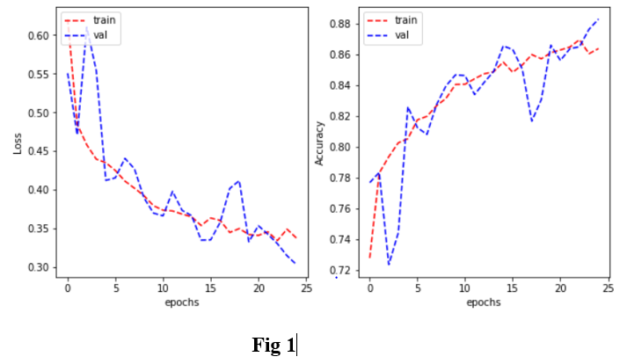
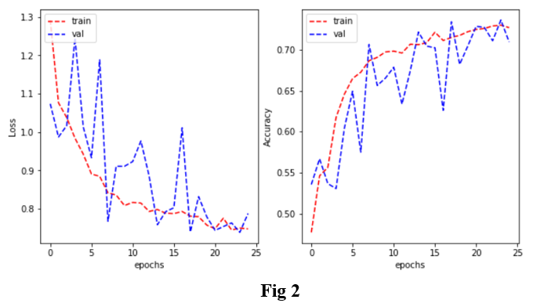
Analysis of the Model
Output of Model 1 (Prediction of cancerous cell):
Best model Regularized ,tuned Augmented image model .
Minimum overfitting with test accuracy 87% , train accuracy 88% [Fig1].
Output of Model 2 (Cell type classification ):
Best model Hyper parameterized Augmented image model.
Least overfitting with test accuracy 70% , train accuracy 75% [Fig 2].
Notes:
Figure shows loss and accuracy curve for final and best model

Slide 6
Other Approach and Limitations of Model
Other approaches considered while developing model :
Other techniques like Logistic regression ,MLP with using only Dense layers did not perform well in terms of accuracy.
Applied concept of Transfer learning where a model developed for a task is reused as the starting point for a model on a second task.
Weights of first model (prediction of cancer) saved using ModelCheckPoint function of callback method.
The weights so saved are used in second task model (classifying cell type) to classify unlabeled dataset.
Limitations of Model :
Transfer learning possible between two model of same architecture .So adopted technique was limited to CNN algorithm only.
Other modelling algorithm like logistic regression ,MLP did gave less accuracy and more loss. Hence, we limited to CNN for both task.

Slide 7

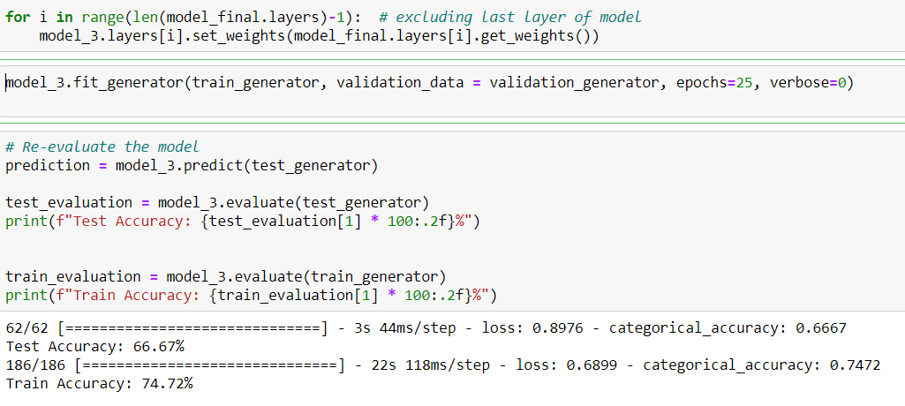
How far our approach be justified in solving problem
Both models used Convolutional Neural Network algorithm ,resulted very good accuracy with minimum overfitting when compared to tested algorithm Logistic Regression or Multilayer Perceptron.
Transfer learning was possible only between these two CNN models (Task1 and Task 2) gave a moderate performance with unlabeled data .
Hence our approach is enough to solve both prediction and classification problem.

Slide 8
Literature Review Of Other Research Papers
Review of Research paper 1
1
Review of Research paper 2
2
Review of Research paper 3
3
Review of Research paper 4
4

Slide 9
Review of Research Paper 1
The first research paper [1] emphasized on Detection and Classification of cell nuclei in histopathology images of cancerous tissue.
Approach in research paper :
For Detection of nuclei, author proposed Neighboring Ensemble Predictor (NEP) algorithm coupled with a Spatially Constrained Convolutional Neural Network (SC-CNN) which is used for spatial regression .
For Classification of cell nuclei , author propose a neighboring ensemble predictor (NEP) in conjunction with a standard SoftMax CNN.
The FI score for detection was approx. 79% and for classification approx. 74%.
Review with other related work & Limitations :
Techniques proposed by other researchers like Cosatto , Al Kofahi , Kuse ,Malon ,Sharma for nucleus detection and classification on histology images ,failed to detect and classify cell nuclei.
Those work mostly rely on morphological features such as shape ,size ,symmetry and stability of the nuclear region . Still their research failed to detect irregular shaped malignant nuclei & evaluation of classification was also limited.
Our Approach :
For classification and prediction of colon cancer cell ,developed three VGG CNN block model with regularized augmented image.
Test Prediction Accuracy :70 % ,Train classification accuracy : 75 %.

Slide 10
Review of Research Paper 2
The second research paper [2] emphasized on using residual network on classification of ImageNet dataset with 1000 classes
Primarily this research addressed the issue of vanishing /exploding gradients.
Approach in research paper :
Baseline mode as plain VGG network of CNN layers with 3*3 filters and Global Average Pooling ,finally FC to SoftMax function.
Advance model build with residuals connections with different layers of ResNet.
Adopted Batch Normalization ,SGD optimizers ( momentum =0.9) , minibatch =256 images , NO Dropout
Comparing to State-of-art-method :
1.ResNet model with 152 layers gave lowest error percentage of 3.57% when compared to other ensembled model tested.
Our Approach
Final model used augmented image , introduction of Dropout =0.2 , Adam optimizer , NO Batch Normalization.
Our error percentage was not that much low as research work, but accuracy was very good.
Notes:
Residual networks are Shortcut connections or Skip connection to skip some layers when the input and output are of the same dimensions

Slide 11
Review of Research Paper 3
The third research paper [3] focused on cell type identification with Deep learning with Sampling technique
This research is different from previous two research papers as it focus on associations between morphological features and various clinical variables.
Approach in research paper :
First approach was random sampling which samples patches of binary mask of image with uniform weighting.
Second approach uses systematic random sampling which takes spatial dependencies into account.
Two CNN model works in series - The ﬁrst network is detection network which locates cells and passed the cell coordinates to the second network, which classifies four cell type : epithelial, inﬂammatory, a ﬁbroblast and “other.”
Detection accuracy was 65% Classification accuracy for cell type shows average of 76%.
Our Approach
Three VGG block in CNN model, and at last layer ,images are flattened and passed through Dense layer which determines cell type.
Our best model gave test accuracy about 70 %. And train accuracy of 75%.

Slide 12
Review of Research Paper 4
The fourth research paper [4] proposed different advanced DCNN models for Routine Colon Cancer classification ,segmentation, and detection.
Approach in research paper :
Densely Connected Recurrent Convolutional Network (DCRN) model is used for nuclei classification.
Recurrent Residual U-Net (R2U-Net) made of U-Net ,Recurrent CNN(RCNN) and Residual Network (Reset) for nuclei segmentation.
R2U-Net regression model which is named UD-Net is used for nuclei detection.
The experiment gave 91.14% classification test accuracy , 92.15% segmentation test accuracy and 0.832 F1 score for cell detection.
Compared to other related state-of-art method :
1. Compared to Research paper 1, (Convolutional Neural Networks(CNN) and neighboring ensemble predictor (NEP) ) , current research paper performed better in terms of average F1-score and AUC.
Our Approach:
Compared to the architecture , we have used simple CNN with three VGG blocks followed by Dense layer at last which classifies cell type.
Our test accuracy was approximately 70% .

Slide 13
Extension Of Existing System To Handle New Challenge
Problem Definition
Approach /Solution
Justification of approach taken

Slide 14
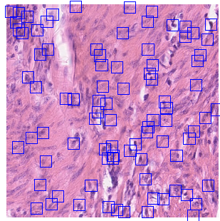
Extension: Problem Definition
To automate the detection and extraction of individual cells from the original histology image with 500x500 resolution of colon cancer images .
Given Data set has a resolution of 500x500.
Individual cells were detected in the original histopathology images.
Images extracted into individual images of 27x27.
Extension is to do cell detection automatically

Slide 15
Extension: Approach and Justification
Proposed Solution :
Using deep learning-based object detection method ‘you only look once’ [YOLO] algorithm to automatically detect cancerous cell types [5].
YOLO algorithm applies a single neural network to the full image, and then divides the image into regions and predicts bounding boxes and probabilities for each region.
Approach:
Divide data in train and test dataset.
For four cell types , set final CNN architecture Dense layer is changed to four outputs.
Yolo Algorithm will resize the image into small grids that predicts for bounding box & confidence score for the boxes.
If the center of the object falls within the grid cell ,then that grid cell will detect that object that is identifies the cell type.
Then predict and evaluate for test data.
Justification :
Extremely fast as compared to another detection algorithm.
It requires only one forward propagation pass through the network to make a fast prediction for both image class and location.
Notes:
Entire process will loop through for all images for cell prediction

Slide 16
Bibliography
1 . Wrap.warwick.ac.uk. 2021. [online] Available at: <http://wrap.warwick.ac.uk/77351/7/WRAP_tmi2016_ks.pdf> [Accessed 31 May 2021].
2. Cv-foundation.org. 2021. [online] Available at: <https://www.cv-foundation.org/openaccess/content_cvpr_2016/papers/He_Deep_Residual_Learning_CVPR_2016_paper.pdf> [Accessed 31 May 2021].
3. 2021. [online] Available at: <https://www.researchgate.net/publication/332016384_Deep_Learning_With_Sampling_in_Colon_Cancer_Histology> [Accessed 26 May 2021].
Arxiv.org. 2021. [online] Available at: <https://arxiv.org/ftp/arxiv/papers/1811/1811.03447.pdf> [Accessed 1 June 2021].
5. https://www.ncbi.nlm.nih.gov/pmc/articles/PMC6718065/
Notes:
All reference has been taken from given links

Slide 17
Thank you

